Slide 1
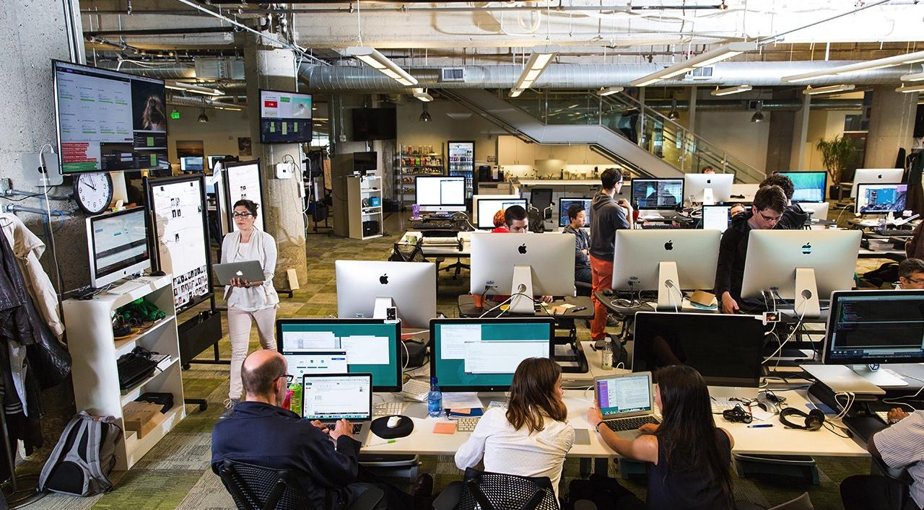

Pivotal
Cloud Native Operations

Slide 2
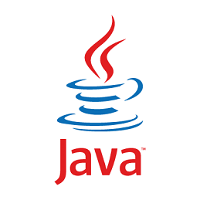
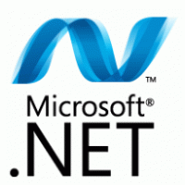
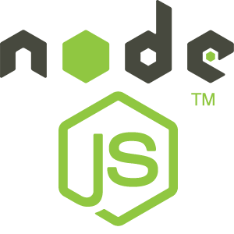
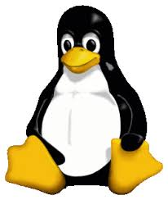
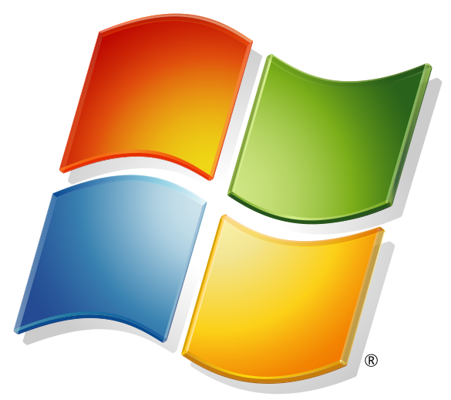
DEVELOPMENT
OPERATIONS
Multiple
Languages
App Deployment
& Management
CI/CD Tools,
ID, Security
Microservices
Support
Health, Metrics
Patching
Availability
Services
Marketplace
Native
User Provided
Partner
Visibility &
Administration
Apps & Platform
Dashboards
VALUE LINE
Operating
System
Container Orchestration
Cloud API
Notes:
The PCF platform provides integration and automation on both sides of this line we’re calling the value line to help IT ops focus their resources where they can maximize the strategic impact of their org.
From Our POV: Everything on top of value line, that is YOUR apps and how quickly YOU can get them out there is what brings maximum value to your business.
You are Improving Developer Velocity and business satisfaction, {point top left}
You benefit from better Uptime, improved MTTR, improved admin-server ratio and reduce the impact of breakages. These are the things that are most visible to the business and external teams {point top right}
{point below line}
And down here, below the line is where we have spent a lot of time on automation so you don’t have to. Everything below is very important, but ultimately non-differentiating to you and your business. No CEO ever said “great job managing those Operating systems”.
Unfortunately, Most of the Ops teams live down here, stuck, trying to build that automation on a per app and per BU basis (below the line). But the real value is actually up here and here and ops teams are making herculean efforts to make a mark here (top of line). Do you agree ? (ask the VP if they agree and see if how they view the world)

Slide 3
DEVELOPMENT
OPERATIONS
Multiple
Languages
App Deployment
& Management
CI/CD Tools,
ID, Security
Microservices
Support
Health, Metrics,
Patching
Availability
Services
Marketplace
Native
User Provided
Partner
Visibility &
Administration
Apps & Platform
Dashboards
Operating
System
Container Orchestration
Cloud API
3
Notes:
So far we have covered how Ops can easily provide the developers what they need to build the applications, let’s talk about deployment and beyond.

Slide 4

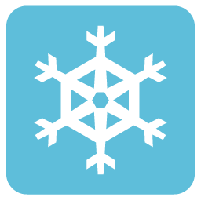

Streamlining Developer Workflows
Reducing Overhead
Design and Coding
Brainstorming
Source: “Electric Cloud LinkedIn Survey to software developers”
Administrative tasks
Managing Environments
Waiting for Test/Build
Average Hours/Week
Snowflake Automation
Structured Automation
Complex/Custom Configurations
Ad hoc, Incomplete Automation
Redundant work for cross-cutting concerns
Difficult to Port/Replicate
Maintenance Overhead
Infrastructure Failure Sensitive
Consistent Contracts
Fully Automated, Repeatable platform managed DevOps processes
Developer + Ops Friendly Constructs
Easy to move/re-architect apps
Infrastructure Failure Agnostic
Platform
Manual, Slow, Inflexible, Error-Prone
Automated, Fast, Flexible, Safe
Notes:
No difference between dev and ops
DEMANDS STRUCTURED AUTOMATION (aka Platform)
Platforms are developed to introduce structured automation and make practices easier; All practices should be supported by matching platforms.
Hence, there need for a cloud native platform.
THE SOLUTION: Structured Automation (aka platform)
The notion of “structured automation” is an important one. It’s easy to fall into the trap of implementing a few scripts that automate some parts of various processes. Without structured automation, you can end up having to deal with snowflake deployments processes – a deployment process comprised of ad hoc, incomplete script based automation that is unique for each application and environment, difficult to port to another cloud and requires significant on-going maintenance overhead. This approach tends to be inflexible, error-prone and reliant on manual effort to tie various pieces of automation together.
What is required is a means to follow processes that remain consistent regardless of the app, environment (on-premise or public cloud), context (dev or ops) or team that is using it – a platform. A platform ensures not just automation and speed, but also consistency, flexibility, safety and reliability. And, in the new DevOps world we live in, it should not only provide streamlined support for shared processes (e.g. environment provisioning, configuring and deployment) and fluid collaboration between developers and operators, but also support the specific needs of the two that support their independent missions.
A platform lets you eliminate distraction and overhead, and focus on the value added activities for the business.
--------------
Add description of why script based automation is inflexible, error-prone, manual
Add description of why Platform is consistent, safe, …
TODO – Add new notes for new content on slide

Slide 5
Full Stack IT Ticket Elimination
Code Complete & Tested
cf push
Find available hosts
Install & configure runtime
Install & configure middleware
Pull application source code
Retrieve dependant libraries
Create application package
Install, configure dependent service(s)
Deploy container to host(s)
Load environment variables
Configure load balancer
Configure firewalls
Update service monitoring tools
Configure log collector
…
--- 2 Days
--- 1 Day
--- 1 Day
--- ¼ Day
--- ¼ Day
--- ¼ Day
--- 2 Days
--- ½ Day
--- ¼ Day
--- 2 Days
--- 2 Days
--- 3 Days
--- 1 Day
...
Speed
&
Consistency
~45 seconds
Application in Production
~15+ Days

Slide 6
Deployment & Buildpacks
Single tool-chain to detect, stage and run any application
Reduce dev technical/security debt with buildpacks. Devs build apps, buildpacks build/maintain rest of the stack.
Buildpacks can provide an appropriate runtime and additional libraries for the apps to be run if needed.
Buildpacks package app and runtime into a single runnable artifact. The Platform then runs this within a new Linux container.
Platform managed rootfs is mounted in every container when using buildpacks as opposed to dev’s creating/maintaining own Docker images with their choice of Linux.
Helps devs be cloud native by adopting 12 factor guidelines

Slide 7
Ingredients of a Buildpack Container
Buildpacks are scripts that can detect applications, install middleware runtimes and package app bits into it.
Also provides scripts to run the application with its dependencies.
Buildpack
App Bits + Middleware
Every container receives a Filesystem image purpose built for CF.
Only necessary dependencies are added to reduce the attack surface and maintainability of these dependencies for security patches
rootfs
Filesystem
Buildpack Container
Kernel & Devices
Provides kernel and its dependencies, devices, network interfaces, semaphores(for compilers)
Primarily Ubuntu 14.04 with support for RHEL7/CentOS7 and Windows Server 2012 coming soon.
Stemcell

Slide 8
Bring your Container(BYC) vs Buildpacks
BYC (e.g. Docker)
Buildpack
application layer
application layer
Dev Provides
System Provides
runtime layer
runtime layer
App container
OS image
OS image
system brings fixed host OS Kernel
system brings fixed host OS Kernel

Slide 9
Day 2 Operations with Buildpacks
Buildpack
application layer
Developer/App team provided
Blue/Green Deployments
Dev Supported
Platform supported
Platform or Dev provided
CVE’s addressed by Pivotal for Platform provided
Blue/Green Deployments
runtime layer
App container
OS image
Platform provided
CVE’s addressed by Pivotal
Canary style zero downtime deployments
system brings fixed host OS Kernel

Slide 10
What is in a Buildpack?
Idea and format of a buildpack was borrowed from Heroku. Many Buildpacks supported on Cloud Foundry derived from Heroku Buildpacks.
Buildpacks are built with a simple API of three bash scripts
./bin/detect app_directory - Inspect app bits to determine type of application.
./bin/compile app_directory cache_directory - Installing the appropriate run-time, packages and libraries as well as packaging the application bits with the runtime if needed.
./bin/release - Returns a YAML payload that describes the default way of how the application needs to be started.
Usage within Cloud Foundry :-
“$ cf push app_name” – Detect scripts of the buildpacks are called to get the application type
“$ cf push app_name -b buildpack_name” – Uses the specified installed buildpack.
“$ cf push app_name -b buildpack_url” – Uses a buildpack hosted at the specified URL.

Slide 11
Cloud Foundry Supported Buildpack
Java – Web(Tomcat), Java, Spring, Play, Grails or any JVM language
Staticfile – HTML, JavaScript or CSS. Supported by NGINX
PHP – php-cli, php-cgi, php-fpm. Supported by Apache & NGINX.
Binary – Run arbitrary binary web servers
Heroku Derived Buildpacks
Ruby – Ruby, Rack & Rails
Go – Go apps
Node.js – node.js apps
Python – Python apps powered by pip

Slide 12
Support any Language & Runtime
Community buildpacks - Built by the CF community to support other languages and runtimes like Websphere, JBoss, ASP.NET, Swift, Haskell, tomEE, R, meteor, Jetty, Clojure, Mono
Heroku 3rd party buildpacks - Built by the Heroku community to support multiple languages and runtimes.
These supported, community or Heroku buildpacks can serve as an extension point for you to customize and run your applications in any language.
You can also build your own custom buildpack by following the Buildpack API discussed before.

Slide 13
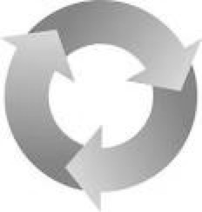
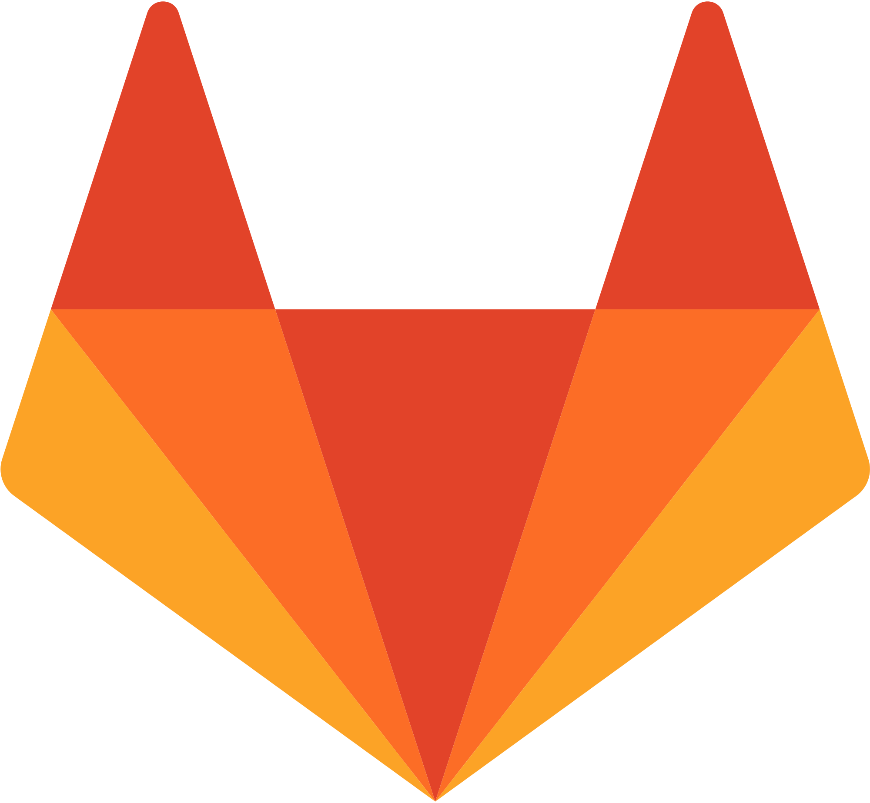
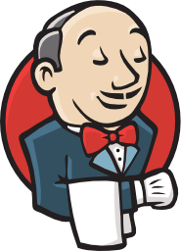

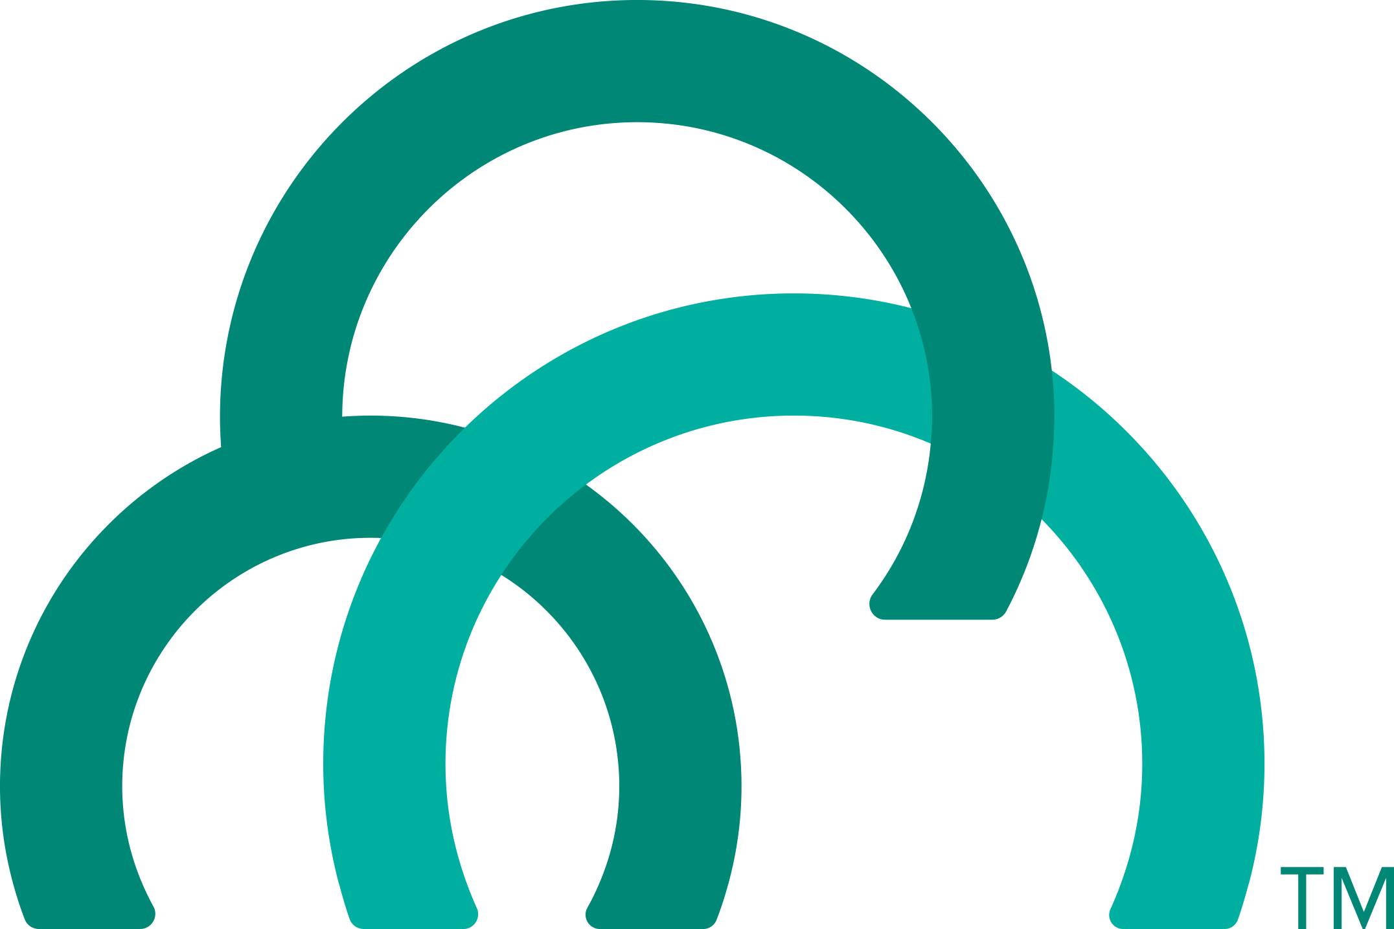
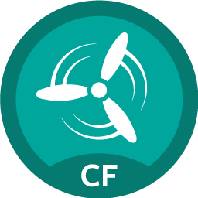
Continuous Delivery Automation
Continuous Delivery Pipeline
Commit Code Change
Automate Build, Test, Deploy
Store Binaries & Build Artifacts
Deploy, UAT, Stage App
Zero Downtime Upgrade to Production
Tool Chain
Gitlab
Jenkins
Artifactory
Pivotal Cloud Foundry
(API Driven)
Concourse
Pivotal HA Services
Notes:
Continuous delivery is key to iterative development process and CI/CD tools provide the framework for delivery process with transparency between Dev and Ops.
First platform built assuming CD as the prime directive. The platform integrates tools and automates processes for full app lifecycle from testing to builds and deployment
It provides a
consistent API to automate deployments,
standard tooling for all apps with
Commits from many teams rolling into production hosted env as fast as possible with safety
GitLab, Jenkins and Artifactory can also be installed on and managed by Pivotal Cloud Foundry, which makes it even quicker and easier to get these platforms up and running.
-------------------Notes on the partner and SCS products for in case of further discussion-------------------
Gitab - Source control product using GIT that includes git repository management, code reviews, issue tracking, wikis , etc. We provide a managed solution, including automated deployment, configuration, scaling & upgrade (via Ops Manager) with persisted data and configuration. Not required to be an expert in Git.
Jenkins - #1 CI tool, 8 years old. Includes the core open source Jenkins technology with advanced enterprise features developed by CloudBees. CB provides professional technical support for Jenkins and 1000+ open source community Jenkins plugins. One click install and scale w/ PCF Ops manager, integrated authentication with PCF UAA to provide single sign-on and support for role-based authentication and authorization
JFrog artifactory - Automate all aspects of artifact management using REST API. Powerful enterprise features and fine grained permissions. Advanced security and reliability features control access to artifacts, where they’re deployed and supports large load bursts with extremely high concurrency+data integrity. Can serve as internal & private docker registry access. Push button deployment , automated upgrades via PCF Ops Manager, with persisted data and configuration. Not required to be an expert in JFrog Artifactory.

Slide 14


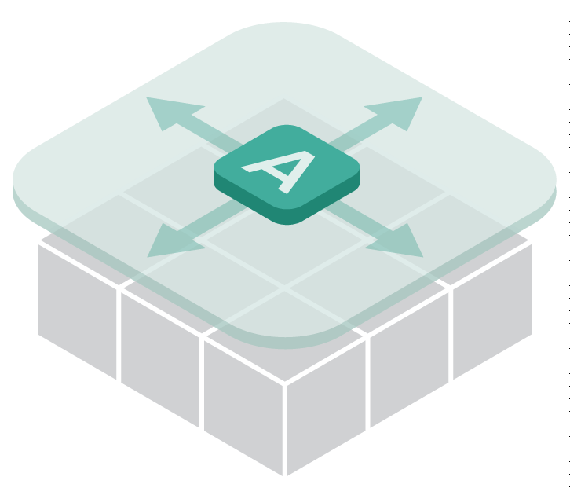

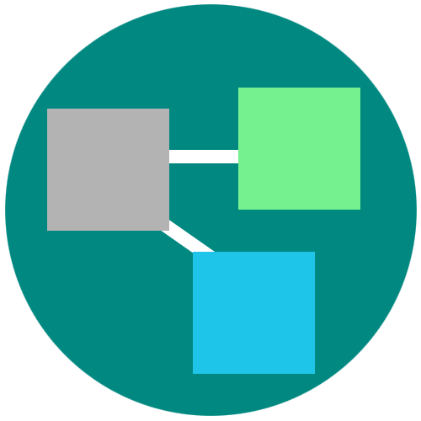



Everything to Deploy and Manage the App
1. Roles and Policy
5. Security and Isolation
6. Blue-Green deployment
2. Metrics
3. Log Aggregation
7. Scaling
4. Health management
Notes:
The previous generations of tools leave a lot of burden on operators. To minimize the number of handoffs and human effort Everything to manage the app is built in to the platform - all the pesky details of getting the app into prod, securing, patching and keeping it available.
PCF provides an abstraction layer that allow you to scale out with application containers as the unit (not the VMs). So…You will no longer need to know which VM or where your app container is running because PCF surfaces visibility at the app layer and not through infrastructure constructs like VMs. The instance of your app is the primitive that PCF uses.
Roles and Identity: Policy enforcement and role based access to platform resources are all integrated and can be set. Using our SSO service, operator overhead of enabling security for apps is drastically reduced because it’s a 1 time setup instead of an app by app effort.
Metrics, log aggregation and health management needed for the resiliency
Instant horizontal scaling; autoscale
Dynamic load balancing and routing: support for instant horizontal scaling
Fast, no downtime updates of your app w/ blue-green deployments (scroll to see optional notes section below)
Security: Security is not a once-and-done endeavor. Treatment of security is broad and ubiquitous to the entire platform. With Pivotal Cloud Foundry, every VM in your datacenter can be repaved automatically from a known good state every few hours. Vulnerable Operating Systems and application stacks can be repaired consistently within just hours of the patch becoming available. And this can be done without application downtime. We could spend a whole session on just this one topic.
<optional: If someone needs an explanation of blue green>
Blue-green deployment is a release technique that reduces downtime and risk by running two identical production environments called Blue and Green.
At any time, only one of the environments is live, with the live environment serving all production traffic (e.g blue). And the updates are applied to the the one that is not live (green).
With a single command, your incoming test traffic to “green” and if that works, eventually your live traffic from blue will be switched to green without the end user experiencing downtime due to the application update.
Once 100% traffic is on green, you can take away blue or keep it around for a bit in case you need to rollback.

Slide 15

Improve Enterprise Security Culture
Makes it easier to do the right things
Prevents vulnerabilities due to
Leaked/misused credentials
Misconfigured/Unpatched software
Slow & rigid processes
15
Notes:
<OPTIONAL> We could spend a whole session on just this one topic.
But to cover a few highlights:
Protection from security threats is done by
Architecting the platform to minimize network surface area with a limited number of contact points with the public internet
isolating customer applications and data in containers
encrypting connections
Applying admin configurable security controls like rules to prevent system access from external networks and within internal components
Simplified vulnerability management, patch management which we’ll see more of later.
Prevents possible denial of service attacks through resource starvation.
The platform makes it radically easier to do the right things that prevent vulnerabilities that are caused by leaked/misused credentials, misconfigured or Unpatched software.
It prevents delays due to well intentioned, but rigid processes – which ironically allow the threat to persist in the environment for a long time even after it is detected.
In general, the Platform focus on automation & abstraction simplifies governance throughout app lifecycle making it a repeatable process that is trivial to implement for your app.

Slide 16
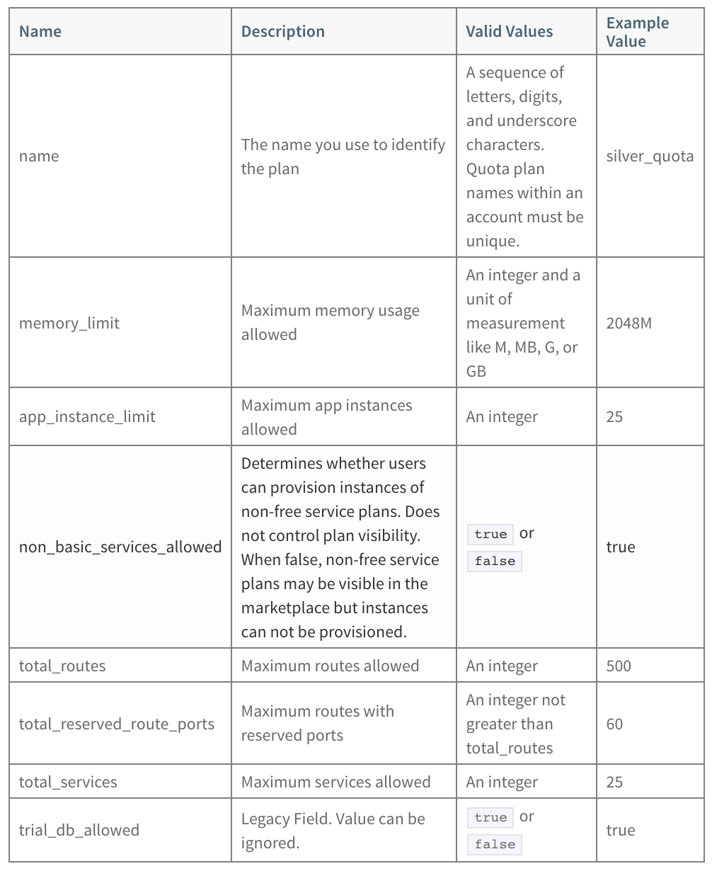
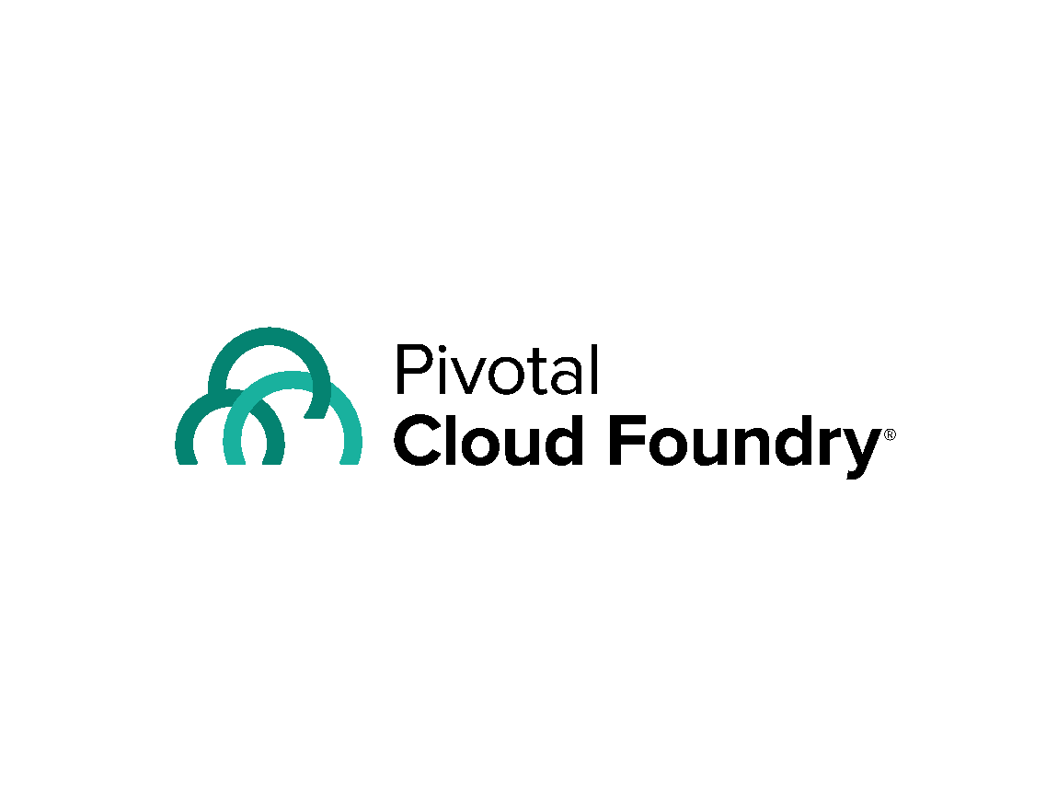
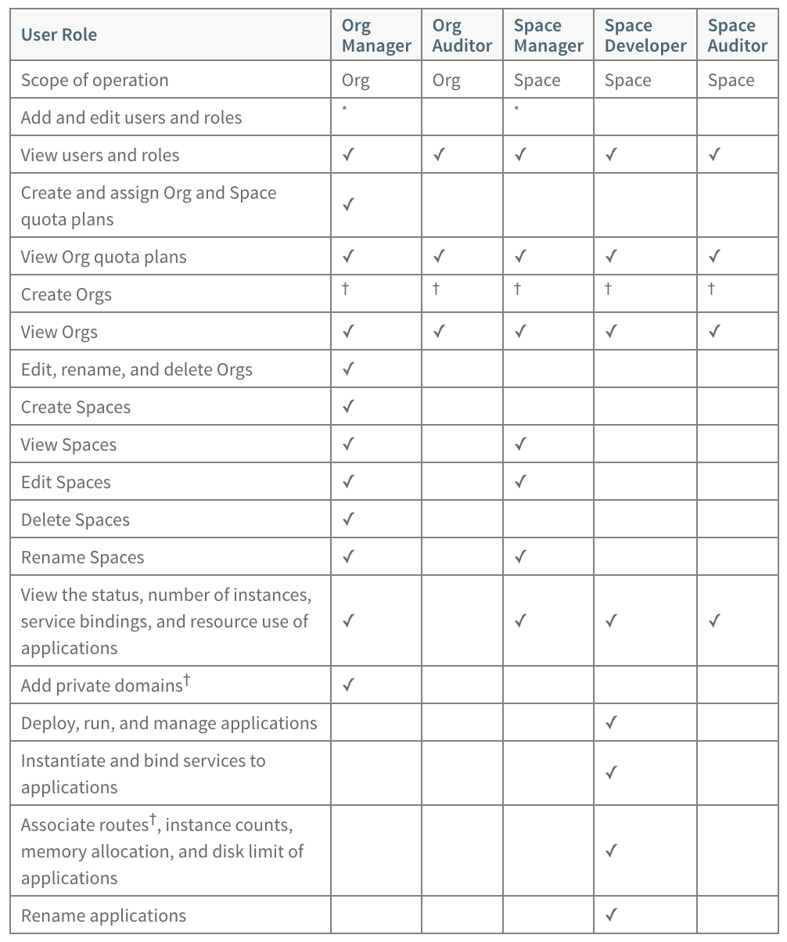

Self-Service Provisioning + RBAC
Enhancing Speed & Consistency of Infrastructure Provisioning
Production
(space)
Q/A
(space)
Q/A
(space)
QA
CLI (cf push, cf bind, cf start, cf scale…)
Organization B
REST
Dev 2
(space)
Dev 1
(space)
Ops
Organization A
Apps Manager
Dev
Notes:
One of the primary hurdles many developers face is waiting to obtain capacity/infrastructure that they can use for development and testing because they do not have direct access to the infrastructure administered by IT. Once devs get access, they may still not have rights to modify for all new requirements/changes during development iterations (e.g. Installing a new service, or scaling the app or DB to do performance tests for new functionality). Thus developers are forced to use a ticketing system which is the source of considerable delay. This generates friction and discourages experimentation, Continuous Delivery and moving fast.
It was hard enough to do with virtualized infrastructure. However, in the world of containers, this provisioning activity becomes highly granular and complex. Today, the unit of infra has changed from VM (which includes both the runtime + config in one place) to containers (runtime) and images (deployment configuration). The higher granularity and separation of images and containers creates greater overhead of managing images + runtime deployment to containers, thereby creating more complexity and delay. Without quota management and proper shared access control for VMs, dedicated machines still need to be given to developers and teams, since it is hard to share the machine to run containers from different teams and still avoid noisy neighbors – your unit of provisioning (VM) does not match your unit of deploy (container). Otherwise, with shared VMs, resource contention and SLAs become hard. Thus, even in the container world, the ticketing way of doing things creates (even more) operating overhead since you cannot share capacity in fluid manner and manually still have to manage access permissions for VMs.
This approach is neither scalable nor fast. If you want to move fast you need to be able to provision, configure, use and dispose environments on demand. This is critical in order to let devs work on new ideas, TDD and to also structure the CD process to work with multiple environments. Thus, self-service provisioning is a huge accelerator and removes a significant pain point for your developers and enables them to build and test new ideas quickly.
Whereas traditionally developers have had to use a ticketing system to have IT provision, configure and provide this software, with PCF, developers can be assigned appropriate roles/privileges in order to be able to self-provision and configure environments.
Let’s see how PCF can help solve these problems. PCF provides the following constructs:
Organizational Structure
Orgs: An org is a resource pool that can be quota managed and shared across multiple collaborators. It consists of multiple spaces. All users in the org share the assigned resource quotas and service marketplace. For example, a line of business may have a corresponding Org for all development activities under it. Or, it might have an org for each application corresponding to the business. There is no set use of org. It is an arbitrary organizational mechanism that can be used as needed.
Spaces: A space corresponds to a shared location for deploying applications. Every application and service is scoped to a particular space. As with orgs, spaces are an arbitrary organizational mechanism that can apply to a single developer sandbox, or a shared team space (e.g. QA).
Users and Roles
PCF has built in user management and can also integrate with enterprise LDAP providers to define user roles and permissions. Each user can have various roles that correspond to different permissions. He or she can have different roles in different orgs/spaces. Some of the roles include:
Manager: Can grant other user permissions, define quotas, create spaces, etc.
Auditor: Can view assignments for permissions, quotas, etc., but not change them
Developer: Can use the space to deploy applications, bind services, scale the application, etc.
Access Methods
CLI: Users can use the CLI to directly work with the platform or use CLI commands in scripts that are part of the CD pipeline
UI: Users can access most of the CLI functionality for provisioning and configuration via a UI dashboard (AppsManager).
REST: Advanced users can build new tools using the platform REST APIs.
Platform Commands (some examples)
CF Push: Stage, package and deploy a software artifact (e.g. war file) to one or more containers. This invokes the buildpack implicitly and deploys the requisite number of application instances.
CF Bind/Unbind: Bind/unbind a service to an application instance. The platform automatically makes service endpoint and connection information available to all application instances of the running application via the environment.
CF Scale: Declaratively scale the number of application instances currently running, either up or down.
Units of Compute & Configuration
Buidpack Droplet: The invocation of the “cf push” command results in the invocation of a buildpack and the creation of a buildpack droplet – essentially an image of the code and dependencies required to run the app that runs in the container. The unit of configuration.
Application Instance: The running container instance for a buildpack droplet. The unit of compute.
Putting It Together
With PCF, buildpacks you can automate creation of deployable buildpack droplet artifacts. PCF platform commands (e.g. cf push, cf scale, cf bind) also automate and streamline provisioning/deployment/scaling/de-provisioning of compute capacity. Together, these capabilities make spinning up new environments and capacity very simple, self-service and fast. Coupled with in-built role-based access control, multi-tenancy and isolation meant for an enterprise environment, you can truly parallelize developer productivity. Thus with appropriate permissions, developers can at any time, log into a org/space to deploy and scale applications into a particular space by invoking simple platform commands through one of several mechanisms. The platform automates the details of provisioning, configuration and deployment of the application to containers. The power inherent in this much simpler model of capacity management radically simplifies and accelerates the developer experience.
With Buildpacks + CD + Self Service Provisioning, the dev/operations overhead of frequent deployments for testing or CD goes away. THERE IS NO DISINCENTIVE TO DEPLOY OFTEN AND MORE FREQUENTLY.
Importantly, all platform capabilities and tooling (e.g. buildpacks, service discovery, metrics/logging, etc.) are available to all users consistently, such that the semantics and behavior are the same all the time, thereby eliminating “snowflakes” and the associated problems.
Benefits
The above makes possible a number of benefits.
Rapid, On-Demand, Self-Service Provisioning & Automatic Configuration: The platform commands eliminate the tediousness of provisioning and configuring environments, allowing developers to work with high level constructs such as applications and services, and move fast.
Consistency: The automation provided by buildpacks and platform commands enable declarative configurations that can easily be replicated, thereby eliminating many of the deployment concerns rooted in environmental disparity, e.g., between developers or CD pipeline stages such as dev and production.
Enterprise Fit: PCF Orgs and Spaces organizational constructs were designed with the hierarchical structure and multi-tenant needs of the enterprise in mind, where a single pool of infrastructure is shared among multiple, stakeholders.
Role Based Access Control (RBAC): RBAC enables strikes the appropriate balance between individual empowerment and centralized control that is necessary for enterprises wanting to move fast.
Quota Management & SLA Assurance: With platform managed resource quotas, developers and teams can be assured of receiving the allocated resources and not having to deal with contention created by noisy neighbors, thereby enabling enforcement of internal SLAs.
Elastic, Fluid, Multi-tenanancy: Since the platform provisions, configures, scales and disposes container sresources from a large global pool, development teams can take advantage of “pooling efficiencies” and easily provision incremental resources temporarily without needing to contend for dedicated peak resources, as the global resource pool is shared dynamically in a true multi-tenant, cloud manner.
Simplified Service Discovery: With platform commands such as CF Bind/Unbind, service discovery and access becomes a simple command whose semantics are preserved regardless of how the application scales. Contrast this with what you would need to do for example with manually providing service credentials to each service instance in the absence of a platform.
---------------
Check if feature description above is accurate. For example, can a user have multiple roles in a space?
Do we support chargeback?
Mention Private service brokers here?
Is Buildpack Droplet the right name?
Also, is it appropriate to call buildpack Droplet the unit of config since some of the config is based service bindings.

Slide 17
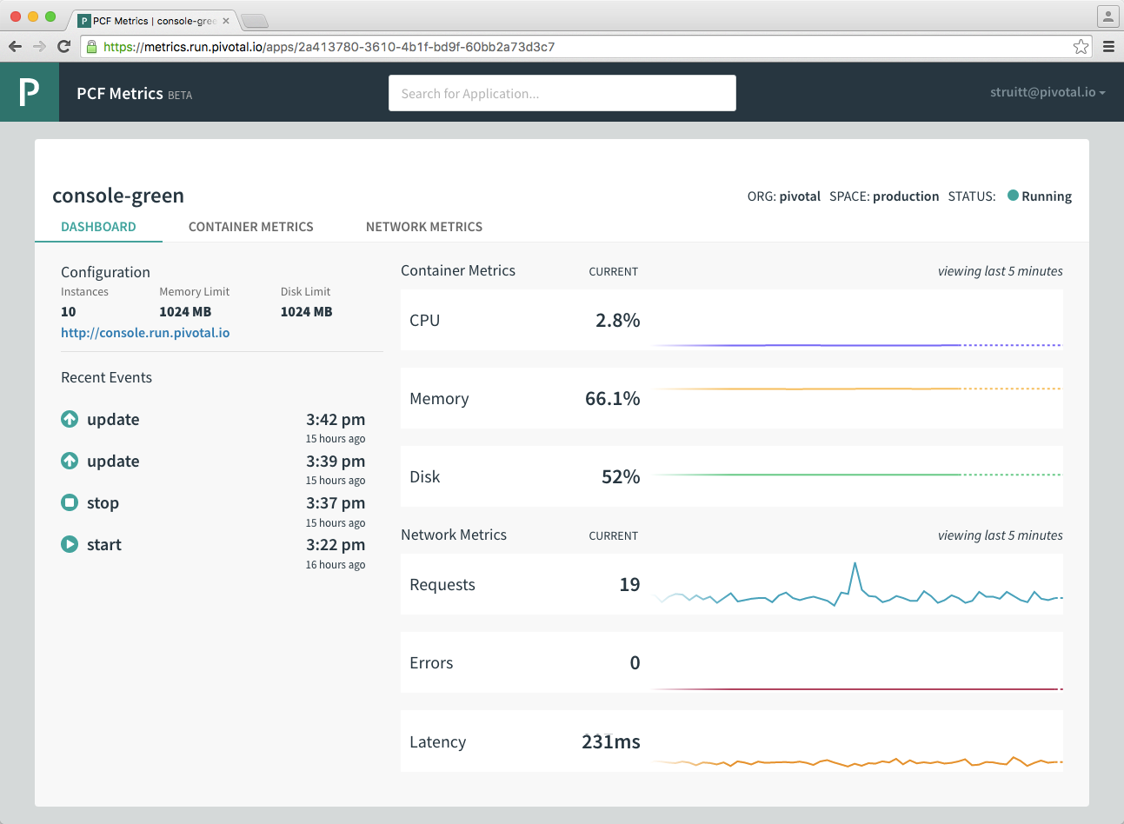
Fast-feedback Monitoring Capabilities
Integrated, near real-time view of key app, services & platform metrics
Devs & Ops have shared understanding of system health / availability
No embedded agent
Simply select an app to watch streaming data
17
Notes:
The platform also helps keep tabs on the running system by providing a near real time, integrated view of the system state. Its surfaces important information on
1) Network metrics
2) Container metrics
3) And App events like when it was created, updated, stopped or crashed
Developers & Operators share an understanding of the app and platform health with the key information that’s needed for problem detection and analysis.

Slide 18
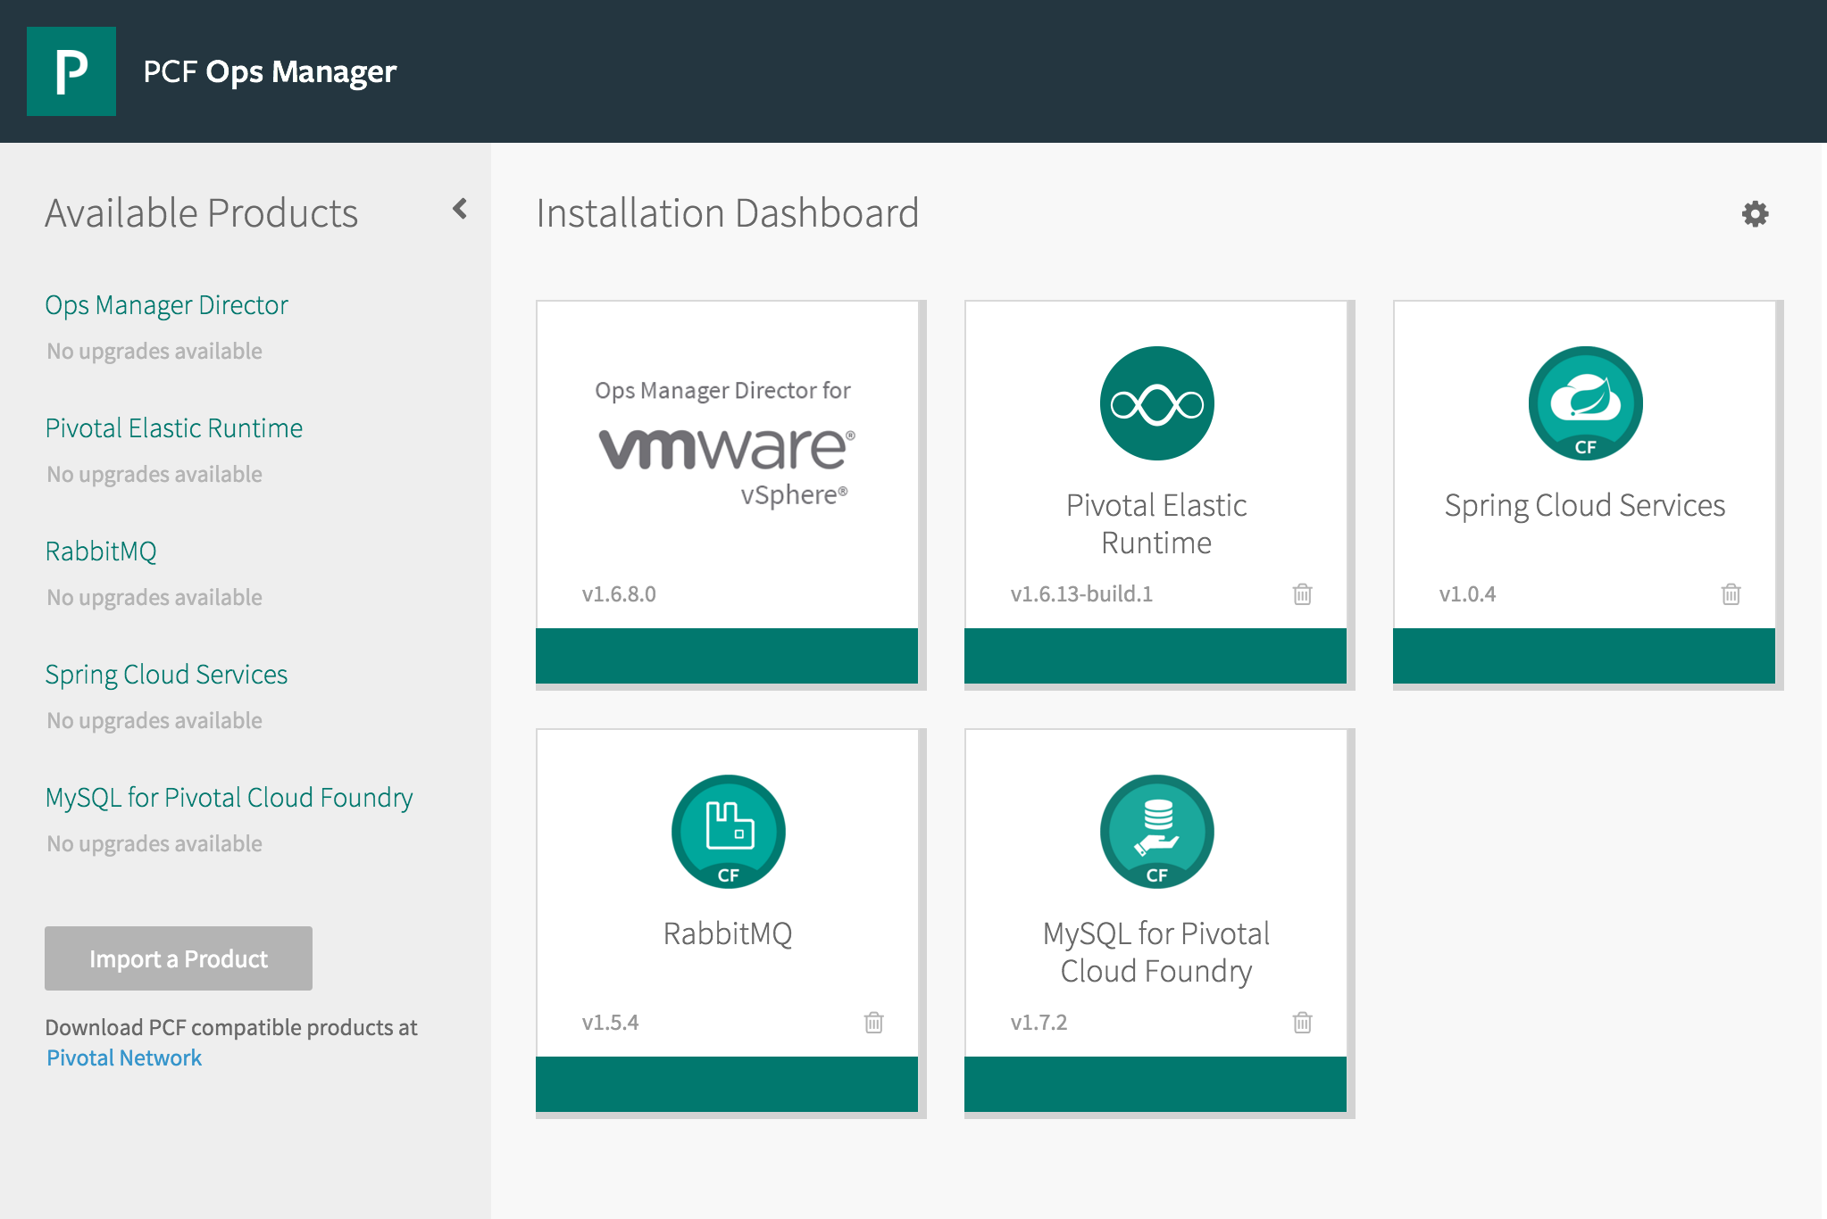
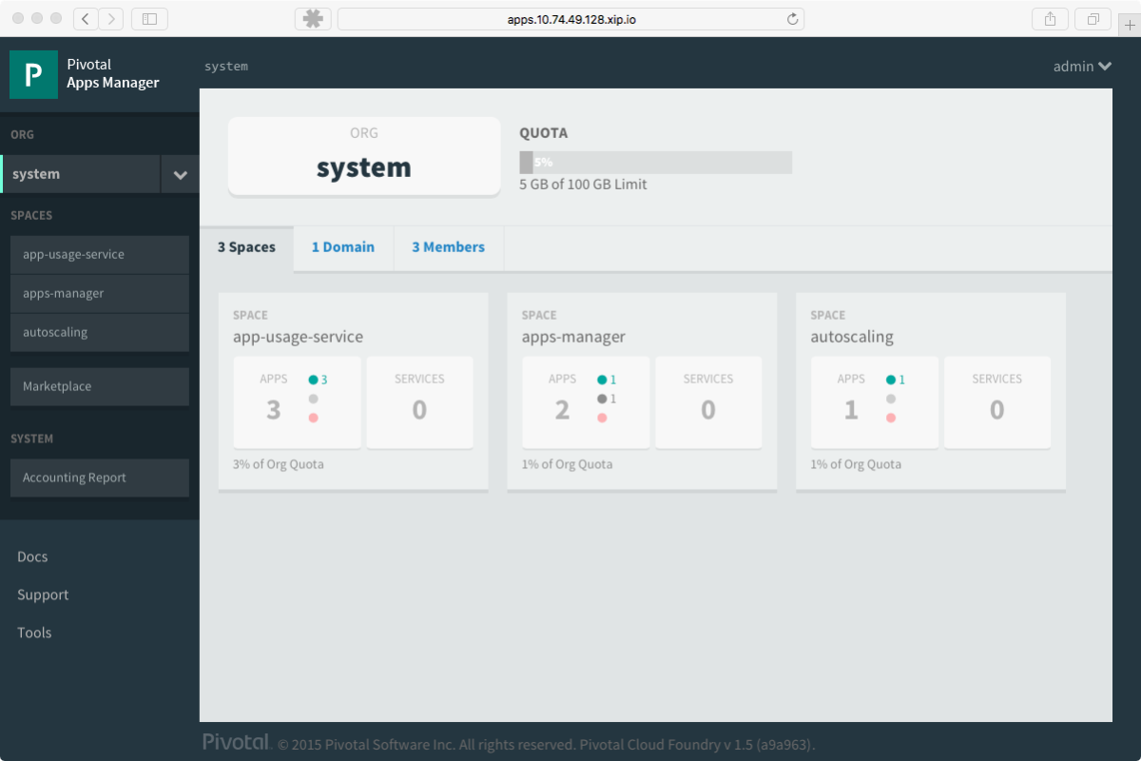
Comprehensive Visibility & Administration
Operations Manager
Applications Manager
Notes:
Consolidated management for Apps and Platform services through Apps Manager and Ops Manager dashboard is available.
Operations Manager is a web application that you use to deploy and manage a Pivotal Cloud Foundry environment on your cloud provider of choice. Its also how PCF products including the Elastic runtime and the services are installed, patched and upgraded as tiles in ops manager GUI. Its one of the ways in which you can monitor VM status and health of your overall PCF installation – like making modifications and scaling of resources that have been allocated to the different platform components. And many of these changes can be done while your apps are in flight.
Apps Manager is the GUI for managing the PCF Elastic Runtime Service and how the operators set the platform up for consumption by the development teams. Elastic runtime can be logically divided by Organizations and further into spaces with fixed quotas. Operators can also use these constructs to assign access to users without going at it on an app by app basis. Apps manager can be used to monitor applications logs, services and routes, set up access to Service Marketplace, increase or decrease the number of instances of an application, how much memory is allocated to it, the status of the application.
Between these two interfaces, operators have comprehensive visibility and administrative capability across the breath of applications, across organizations and across products and runtimes.

Slide 19
Blue / Green Deployments
www.example.com
Blue Deployment
www-blue.example.com
GoRouter
www.example.com
Green Deployment
www-green.example.com

Slide 20
Application Scaling
Applications can be scaled 2 ways
Vertically - add more memory / disk per instance
Horizontally - add more instances
Horizontally scaling can be manual or automatic
Autoscaling is bound as a service to an application
Autoscaling supports HTTP Throughput, HTTP Latency, CPU Utilization and scheduling

Slide 21
Platform Scaling
Platform scaling is performed by the cloud operator
Scaling is done in the resource config tab in Ops Manager
For elastic runtime, only a few components typically need to be scaled for capacity
GoRouter
DEA / Cell
Loggregator / Doppler
More information on platform scaling can be found here: https://docs.pivotal.io/pivotalcf/concepts/high-availability.html#capacity
F

Slide 22
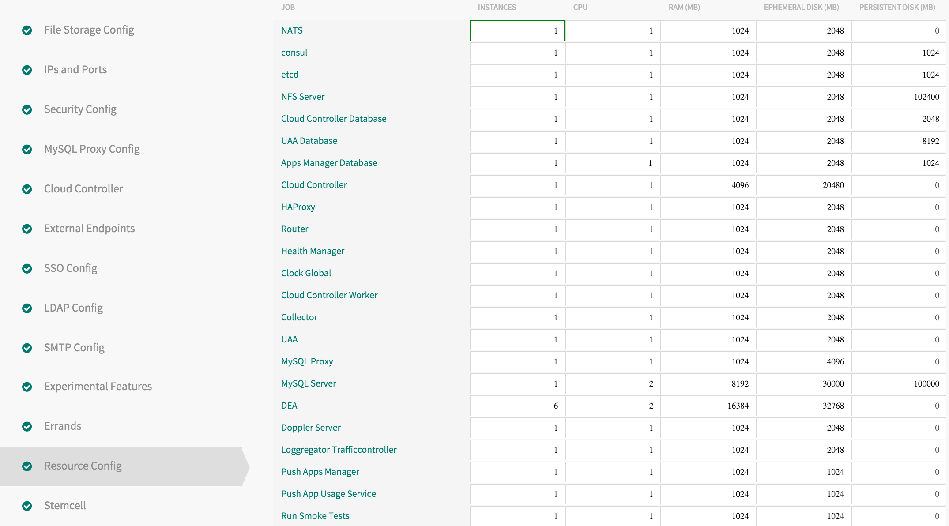
Platform Scaling

Slide 23
DEVELOPMENT
OPERATIONS
Multiple
Languages
App Deployment
& Management
CI/CD Tools,
ID, Security
Microservices
Support
Health, Metrics,
Patching
Availability
Services
Marketplace
Native
User Provided
Partner
Visibility &
Administration
Apps & Platform
Dashboards
Operating
System
Container Orchestration
Cloud API
Notes:
And finally, automation’s goal is to ship comprehensive cloud services not ad-hoc automation

Slide 24
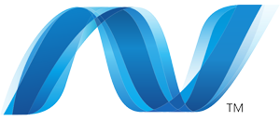
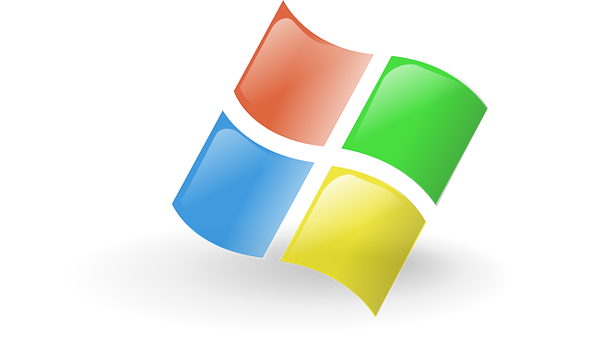
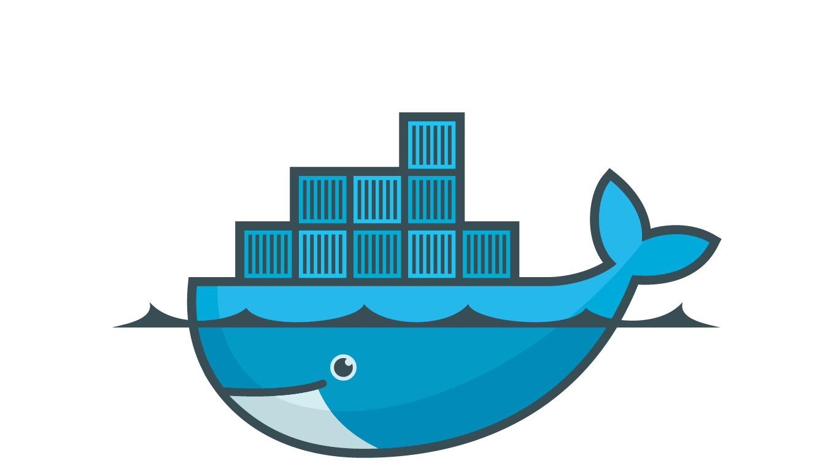
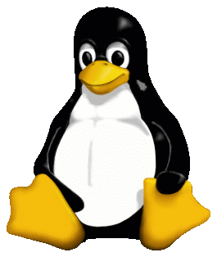

Container Scheduler Handles Workloads
Notes:
Pivotal Elastic Runtime is actually one of the most mature linux container scheduling environments in the world.

Slide 25
Container Scheduler Handles Workloads
Dynamic load balancing
Notes:
The platform distributes new work as it arrives and uses a pretty sophisticated process. A sophisticated algorithm balances application processes over the virtual machines and an Auction determines which processes should be allocated to which VMs while optimizing for application availability and resilience.

Slide 26
Container Scheduler Handles Workloads
Dynamic load balancing
Remediation and rebalance of workloads
Notes:
The platform monitors the applications, and if any of them crash, they get restarted and rebalanced across available capacity.
<CLICK>And as mentioned before the platform attempts to revive the VMs. None of this requires human intervention. (animation that shows this)

Slide 27

Each Layer Upgradable with No Downtime
Application
C o n t a i n e r
Blue-Green deploy
App Runtime*
Exploratory Questions:
How do they patch and upgrade today?
Do they do blue green deployments?
Are there any penalties to downtime or SLAs they are trying to meet?
File system mapping
Canary style deploy
Linux host & kernel
* e.g. Embedded webserver, app configurations, JRE, agents for services packaged as buildpacks
Notes:
The dotted line you see is the marketecture for a container. With PCF, the platform operator has push button control of the full s/w stack.
The app itself can be updated using BG deploys (Explained below)
The App Runtimes can be updated the same way. We talked about buildpacks a little earlier in relation to how they automatically determine what runtime resources are called on by the platform to deploy the app.
The buildpacks that we provide with the platform are constantly updated by Pivotal with the latest security fixes
Applying a patch or upgrading a buildpack is done by the operator with a single command.
The changes are applied to the app instance at the next cf push.
The user traffic can then seamlessly transition to the new app instance using blue-green method as usual.
And finally, operating system patches and upgrades are applied via what we call rolling canary deploys that are done “in flight” across batches of VMs until the update has permeated the whole system.
{{Pivotal platform architects can extend the script and spend more time and detail on this image asking how their org reacts to CVEs like shell shock. They can go over in detail how we can update each layer w/o using this script}}
<optional: If someone needs an explanation of blue green>
Blue-green deployment is a release technique that reduces downtime and risk by running two identical production environments called Blue and Green.
At any time, only one of the environments is live, with the live environment serving all production traffic (e.g blue). And the updates are applied to the the one that is not live (green).
With a single command, your incoming test traffic to “green” and if that works, eventually your live traffic from blue will be switched to green without the end user experiencing downtime due to the application update.
Once 100% traffic is on green, you can take away blue or keep it around for a bit in case you need to rollback.
<optional: If someone needs an explanation of canary>
When performing updates, PCF does things in batches. It allows you to specify a small number of VMs in the first batch to change.
The first batch is called the canary. PCF redistributes the workloads in to others and runs the update.
If the canary batch fail to upgrade then the deployment/change is halted. Your remaining VMs are unaffected and workloads still running. Your canary VMs are left as they are - probably broken in some way - ready for you to diagnose and fix.
If the canaray passes, the updates rolls through. Each time a subset of VMs is taken and updated the same way until all are done.
The name comes from history. Miners carried caged canaries (birds) down into the mine tunnels with them. If dangerous gases such as carbon monoxide collected in the mine, the gases would kill the canary (which is anatomically very sensitive to poisons) before killing the miners, thus providing a warning to exit the tunnels immediately.
http://stackoverflow.com/questions/16047306/how-is-docker-different-from-a-normal-virtual-machine

Slide 28

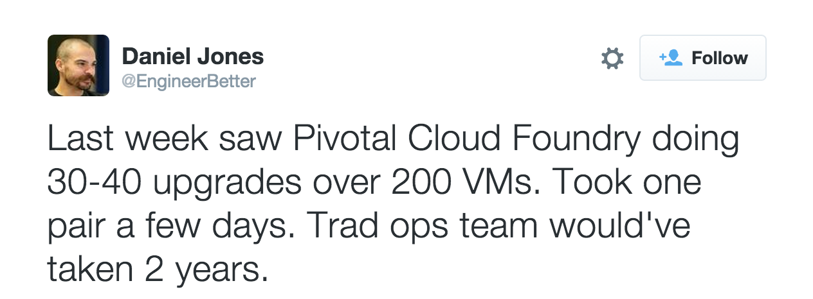

Patch With Rolling Deploys
Notes:
This comes in pretty handy because there have been so many CVE’s lately. When the heartbleed virus hit, our customers took our patch and using canary deploys the fix ran itself across all the VMs under PCF in the data center. All they used was our GUI and 2 easy commands. And one of their engineers actually tweeted their experience where it took 2 people a few days to apply the fix, whereas if they had used traditional tools, it could taken up to 2 years to get it all.
And if devs were rolling their own Docker, without this kind of functionality, this could very quickly turn into a operational nightmare. (See below)
====== Optional talk track===============
Fun Trivia: Over 30% of all official images on the Docker hub contain high priority security vulnerabilities. This stat increases to 70% when you consider the medium priority secure vulnerabilities. PCF provides choice between deploying pre-built images or creating the container “just in time” using buildpacks. The buildpacks approach reduces customer risk by providing a controlled approach to the contents of the container and minimizing the effort required to patch the OS and language level CVEs.

Slide 29

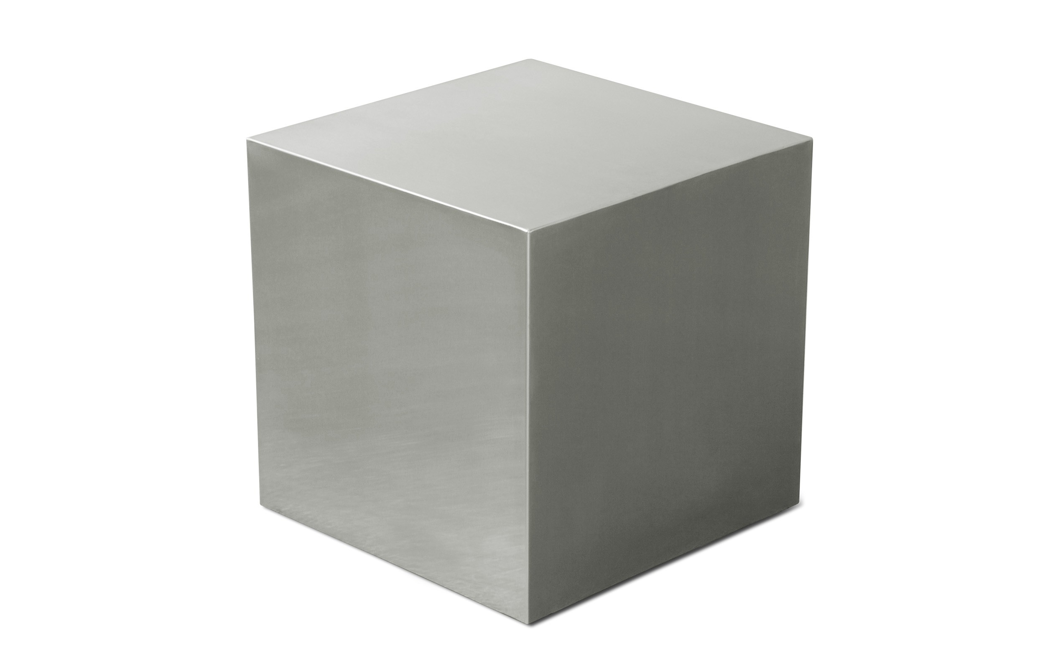
“Cloud is about how computing is done, not where”
Paul Maritz , Founding CEO
CF BOSH Director
Cloud Provider Interface
VM
VM
VM
Agent
Agent
Agent
IaaS
Cloud API
Multi-cloud Advantage:
Cloud agnostic view of app & platform operations
Notes:
Our founding CEO Paul Maritz has said “Cloud is about how computing is done, not where”
Our whole system was architected taking a cloud agnostic view of platform operations with one tool chain to “rule them all”. This is what led to the creation of one of the coolest components of Cloud Foundry - CF BOSH.
We’re showing a very high level marketecture here of something that’s actually pretty complex and involved.
The CPI or the cloud provider interface serves as the IaaS abstraction layer
The BOSH Director is the core orchestrating component and controls the creation and deletion of VMs, disks, & networks via the CPI and BOSH agent.
The BOSH Agent takes instructions from the Director for its VM - like what are the packages to install, what are the configurations to make for the kind of job its has to do i.e. run an app, a service, or a platform component.
With most Pivotal customers, their operators interact and leverage BOSH capabilities via the Ops Manager that we spoke about earlier. Ops manager deploys and manages PCF cross a variety of IaaS clouds in a very simple way, with pretty much the same experience across all of them for managing the resources for the platform and apps.

Slide 30
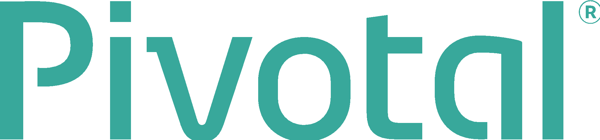
Q&A

Slide 31


